Slide 1





Suboptimality in DeFi
Aviv Yaish, Maya Dotan, Kaihua Qin, Aviv Zohar, Arthur Gervais

Slide 2
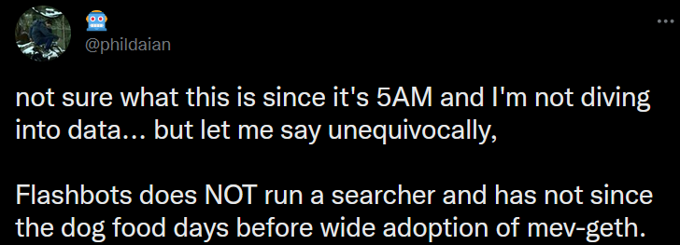

Overview
DeFi users and tools perform suboptimally
Three primitives (TVL>$16 bil): collateralized lending, flashswaps, flashswap-based liquidations
Cast each as an optimization problem
Suboptimality illustrated via a series of case studies
Lenders: can increase short-term profit by over 100%
Arbitrageurs: could improve by <4.2 million USD
Surprising circumstantial evidence: how do private TX channels make money?

Slide 3

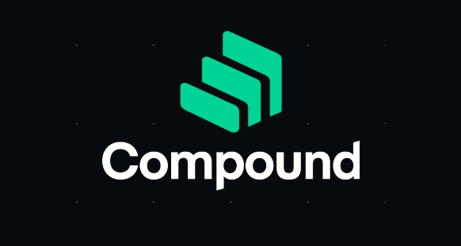
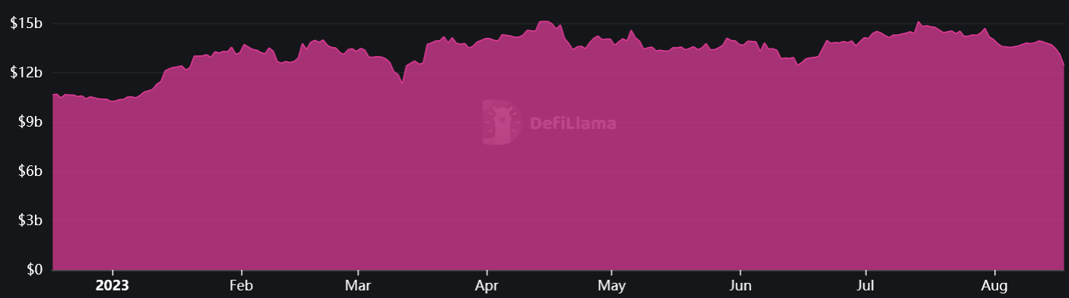
Part I: Lending Suboptimality
Users can lend & borrow funds
Interest determined algorithmically
Source: defillama.com

Slide 4
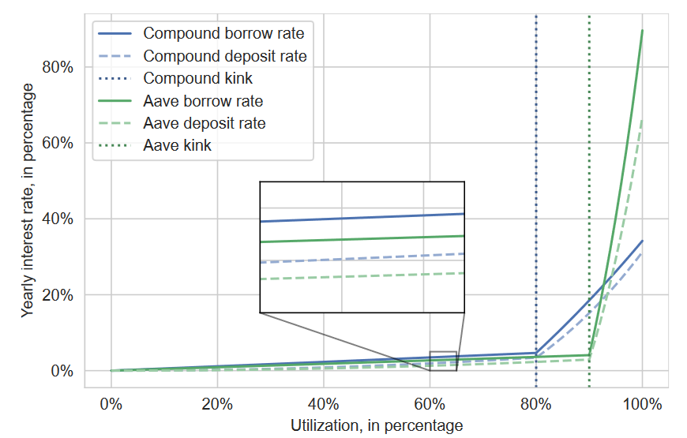

Interest Rates
$Utilization= \frac{borrows}{deposits}$
Interest = monotonically increasing in utilization
Incentivizes repaying loans,
adding new liquidity
Incentivizes taking loans

Slide 5
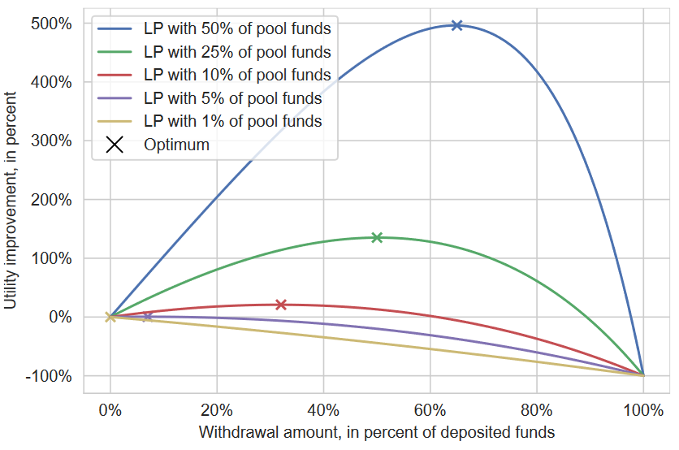
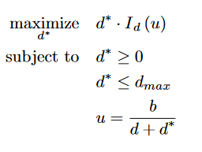
Short-term Optimality

Slide 6
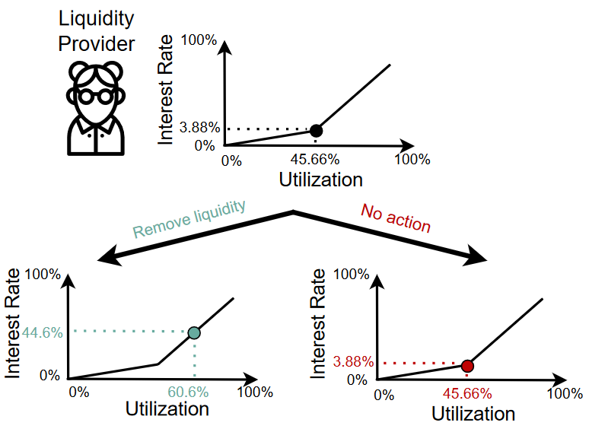
Whales Dictate Utilization
AAVE’s CRV pool, Sep ’22:
1 user supplies 80% of liquidity
Can withdraw 28% of funds
Get 700% abs. short-term profit

Slide 7
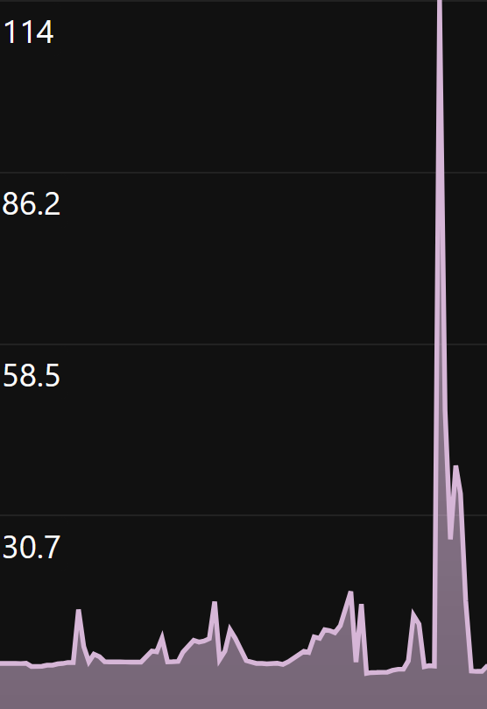
Limitations
Long-term sustainability not assured
Works for thinly-traded assets
Proof of concept came few months after publication
One week
Source: aavescan.com

Slide 8
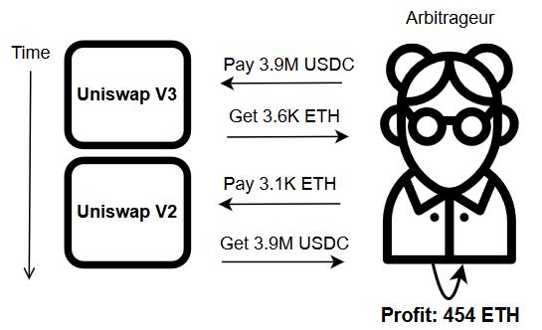
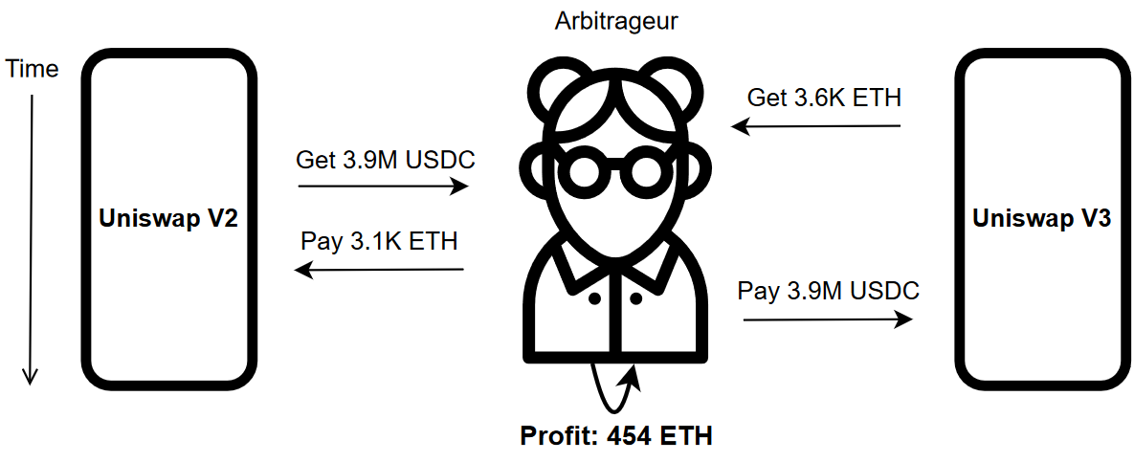
Part II: Flashswap Suboptimality
Exchanges like Uniswap (& clones) have +$4 billion TVL
Arbitrageurs find and close arbitrage opportunities
Some capital is needed
Flashswap: get capital, use it, repay exchange (or TX reverts)
Get capital via flashswaps
1083 USDC/ETH
1258 USDC/ETH
Swap!
8

Slide 9
Suboptimality Heuristic
Heuristic: consecutive flashswaps exploiting similar arbitrage types
Backrunning arbitrage can’t exist if 1st TX is optimal
First TXs are suboptimal
Block
TX1 Flashswap arbitrage
TX2 Flashswap arbitrage
TX3 Flashswap arbitrage

Slide 10
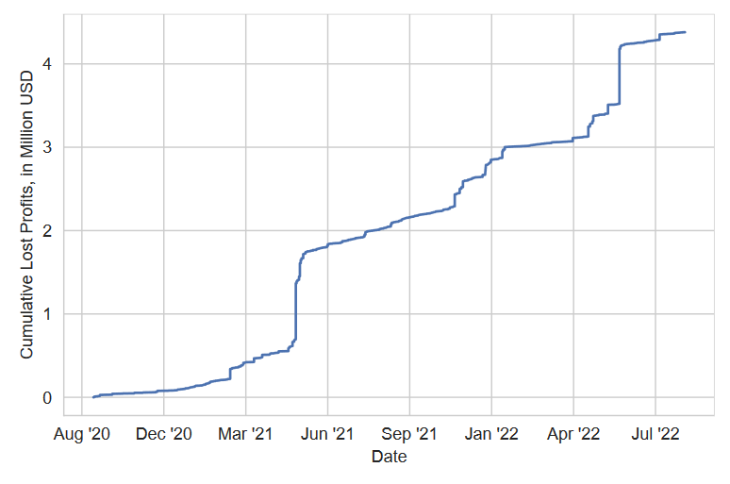
Arbitrage Suboptimality
Average: 2.91 ETH/day
Total: 4.6 Million USD
Largest cases
428 ETH, ~517K USD, 94% improvement
170 ETH, ~694K USD, 770% improvement
Suboptimality is reasonable
Action space is huge
Tooling is mediocre
The data is hiding a few other secrets!

Slide 11
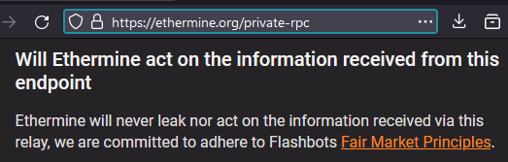
Private Orderflow?
Some builders let users send TXs in private, for free
Ethermine: “never leak nor act on the information received via this relay”
Arbitrageur 0x584... appears only in Ethermine’s blocks
0x584… & Ethermine’s relay started & stopped working at ~ the same time
Some TXs are in suboptimal TX sequences that include private orderflow

Slide 12
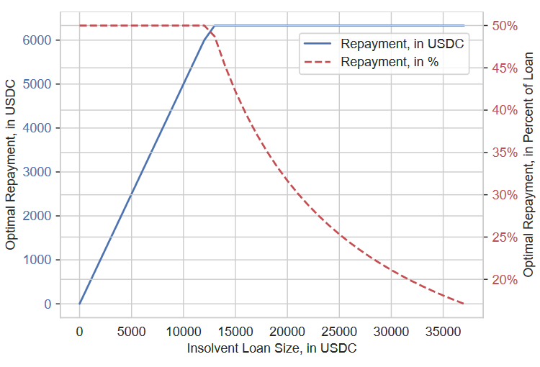
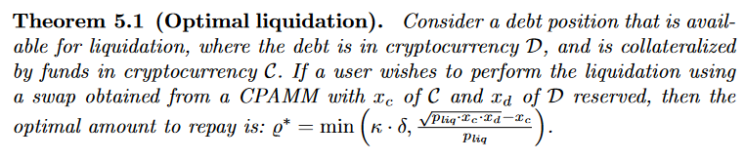
Part III: Liquidation Suboptimality
Repay bad collateralized debt, get collateral at a discount
Get initial funds via flashswaps (or flashloan & swap)
Swaps affect exchange-rates (“slippage”)
Disincentivizes large liquidations!

Slide 13


Part III: Liquidation Suboptimality
2000 USDC = 1 ETH
2200 USDC = 1 ETH
Deposit 120% collateral
2400 USDC
Lending pool
Exchange
Overcollateralized loan
1 ETH
What if ETH lenders want to cash out?
Pool needs 1 ETH!
Get flashswap
1 ETH
Borrower
Repay loan
1 ETH
What if the liquidator doesn’t have 1 ETH?
Not 120% anymore
Get collateral
2400 USDC
Repay flashswap
2200 USDC?
Liquidator
But swaps can change the exchange-rate!

Slide 14
Conclusions
DeFi users behave suboptimally
Lack of tools, awareness → inefficient market
Full paper has more details, case studies
Future work
Better interest rate mechanisms
Long-term lending

Slide 15
Thank you! Questions?

